Slide 1
CSE326:PROJECT REPORT BLOGGING WEBSITE BY:RAJIV KUMAR SINGH SEC:KOC07 ROLL.NO:70 REG.NO:12216012

Slide 2
INTRODUCTION
This is basically a blogging website which publishes the articles by different users of this website. This is a website which lets you submit an article which upon approval will be up on our website and you can get a good amount of reach from here!

Slide 3
TAGS USED
<html>
<p>
<br>
<div>
<span>
<hr>
<img>
<h1>
<h2>
<h3>
<a>
<nav>
<li>
<body>
<head>

Slide 4
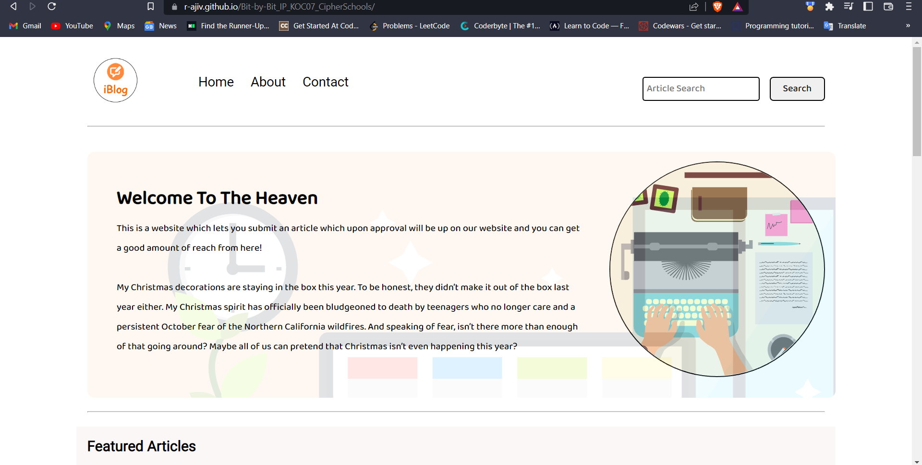
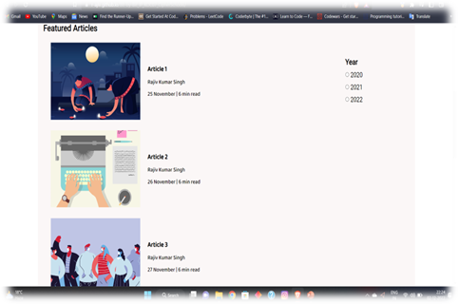
WEBSITE PICTURES

Slide 5
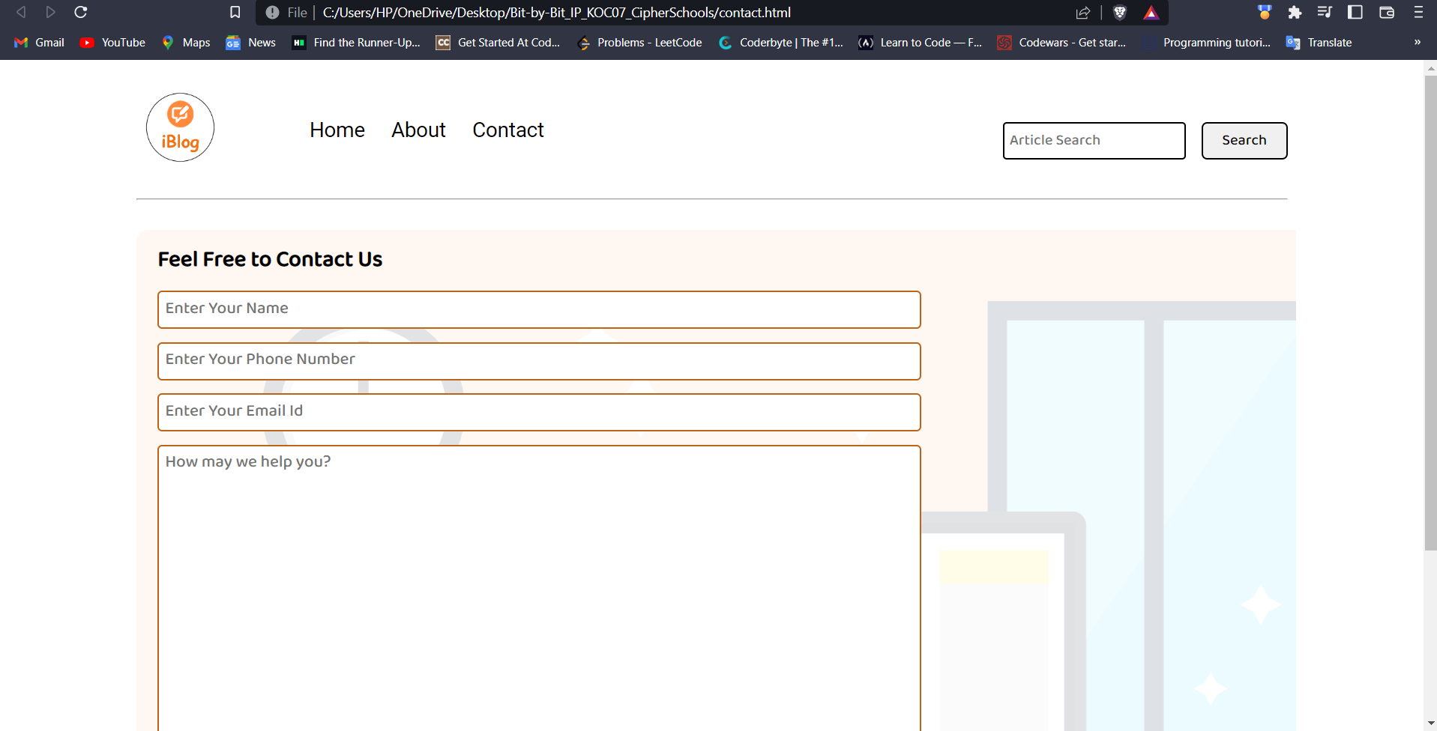
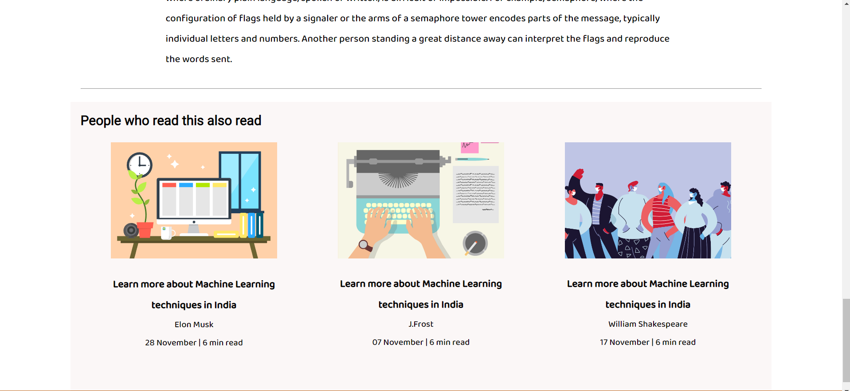

Slide 6
THANK YOU😊

